Slide 1


Slide 2
Get Started
Extract Zip
Invite 1-3 friends
Start VirusX
Have fun!
The Game requires .NET 4.0 and XNA4
A XNA4 Installer is contained in the Zip

Slide 3
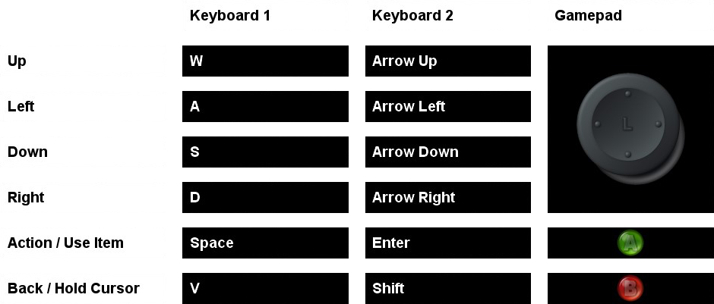
Controls

Slide 4
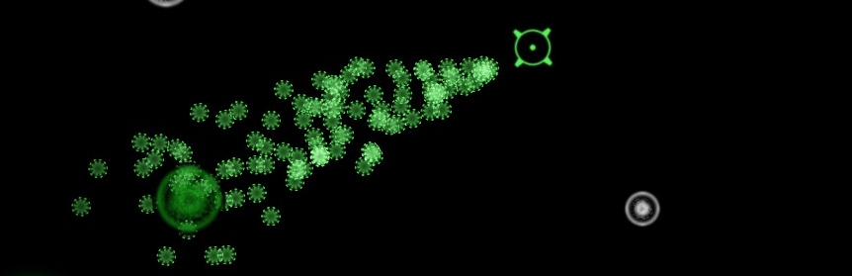
How to Play
Move your viruses using your cursor
Nuclei produce new viruses

Slide 5
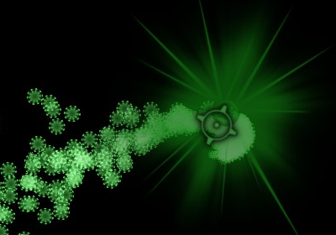
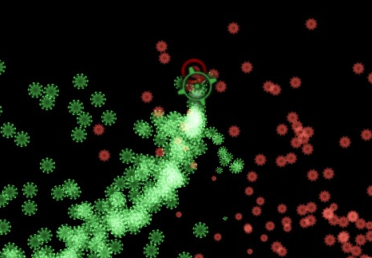
How to Play
Capture cells by taking over nuclei
Defeat your opponent’s cells

Slide 6
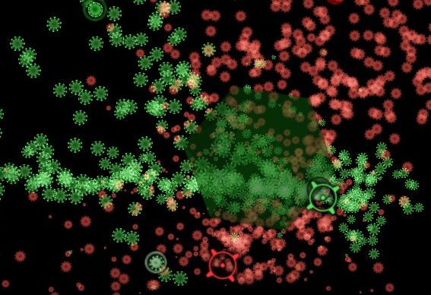
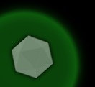
How to Play
Use items!
Collected items are shown in your corner

Slide 7




Objects
Gather items!
Safe Zone - kills opponent’s viruses
Switch - possessions are shuffled
Wipe Out - nearly all viruses die
Beware!
Anti Body - kills nearby viruses

Slide 8
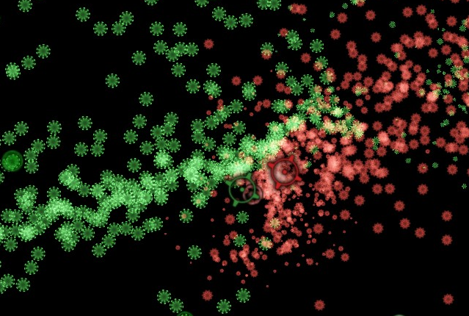
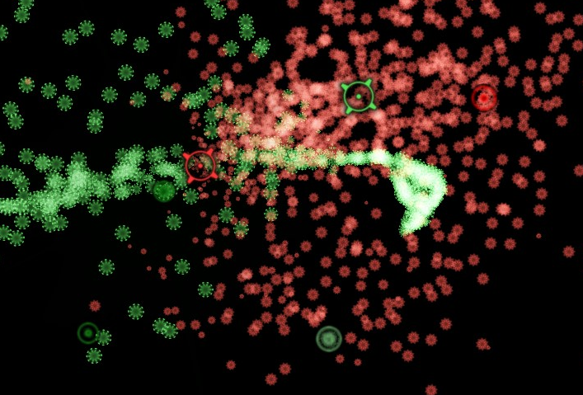
How to Win
Kill all enemy viruses
Have fun!

Slide 9
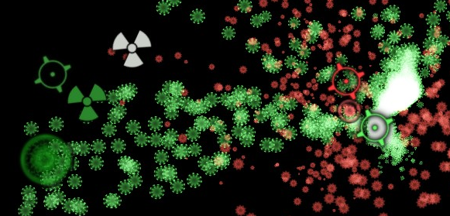
Advanced
Hold-Move to separate virus-aim and cursor

Slide 10

Thanks for playing
Andreas Reich
Enrico Gebert
Sebastian Lay
Maria Manneck

